Slide 1

C# CODE STRUCTURE
.NET/Microsoft Dynamics 365

Slide 2
Don’t start jumping into design, creating folders as they come, adding features when you think about it. Sit down for a minute, think clearly about what resources you will need, which technologies or languages you will use and how to structure all this. Write down all those criteria in a document you will keep for future reference and build your structure accordingly.
- Julien rio

Slide 3
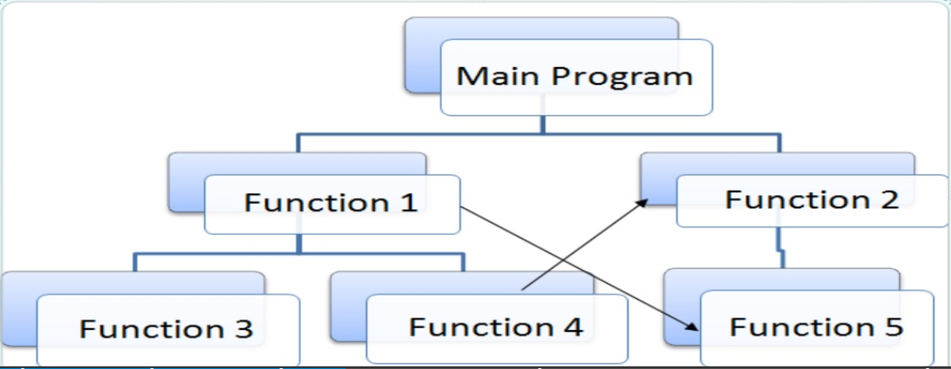
Procedural Programming https://en.wikipedia.org/wiki/Procedural_programming
Procedural programming is a programming paradigm derived from ‘structured’ programming, based on the concept of the procedure call.
Procedures (routines, subroutines, functions, methods) contain a series of computational steps to be carried out.
A method can be called at any point during a program's execution by other methods or by itself (recursion).

Slide 4
Your first Visual Studio program https://docs.microsoft.com/en-us/dotnet/csharp/tour-of-csharp/#hello-world
Hello World
To create this program, first download and install the .NET Core SDK.
Then, execute the command dotnet new console -o hello to create a new program and a build script. (Alternative – Hello, World in VS.)
The program and build script are in the files Program.cs and hello.csproj, respectively.
In the command line, type cd hello.
Build and run the application with the run command: dotnet run

Slide 5
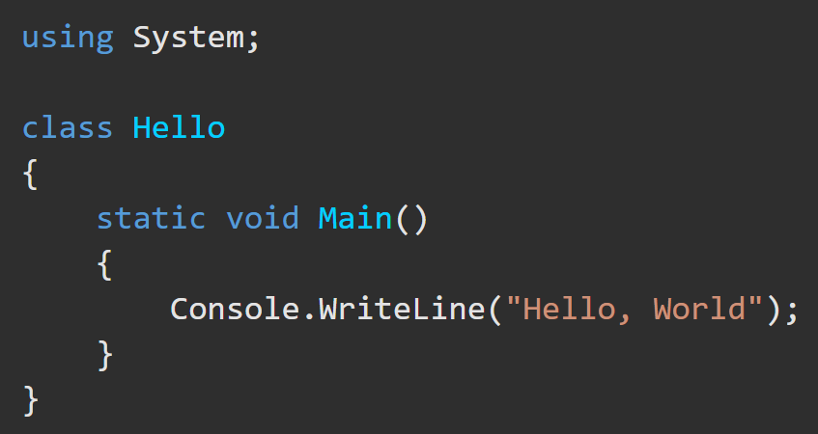
C# - Hello, World https://docs.microsoft.com/en-us/dotnet/csharp/tour-of-csharp/#hello-world
Hello, World starts with an (optional) using directive that references the System namespace.
Namespaces provide a hierarchical means of organizing C# programs and libraries. Namespaces contain types and other namespaces (System namespace contains the Console class, I/O, Collections, etc).
A using directive allows use of all type members of that namespace. Hello, World can use Console.WriteLine as shorthand for System.Console.WriteLine.
The Hello class declared by the "Hello, World" program has a single member, the static method named Main.
By required convention, a static method named Main serves as the entry point of a program.
The WriteLine method of the Console class in the System namespace provides output. This class is provided by the Base Class Library, which is automatically referenced by the compiler.

Slide 6
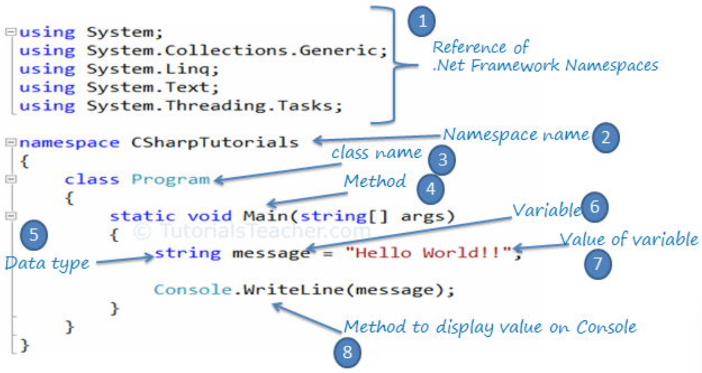
C# Program Structure https://docs.microsoft.com/en-us/dotnet/csharp/tour-of-csharp/program-structure

Slide 7
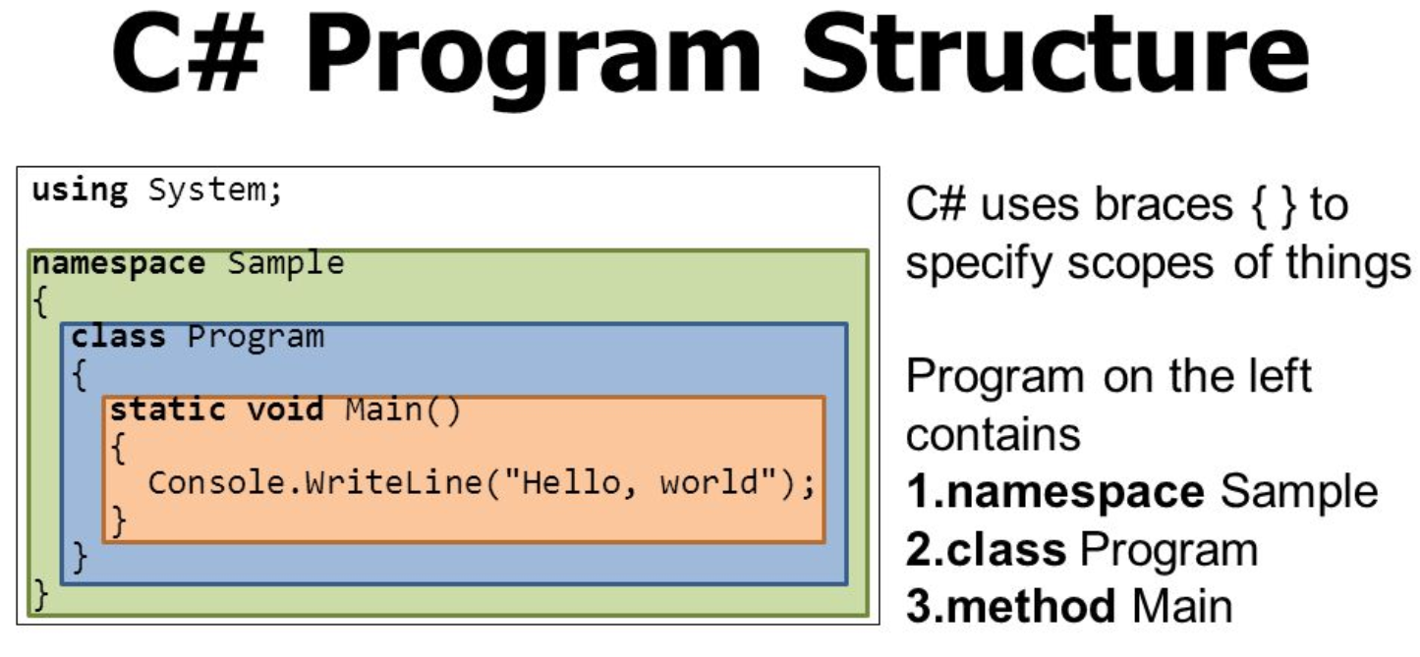
C# Program Structure https://docs.microsoft.com/en-us/dotnet/csharp/tour-of-csharp/program-structure
The key organizational concepts in C# are programs, namespaces, types, members, and assemblies.
C# programs consist of one or more source files.
Programs declare namespaces.
Namespaces contain types (classes/interfaces).
Types contain members (Fields, methods, properties, events)
When C# programs are compiled, they're physically packaged into assemblies with file extensions .exe or .dll.

Slide 8
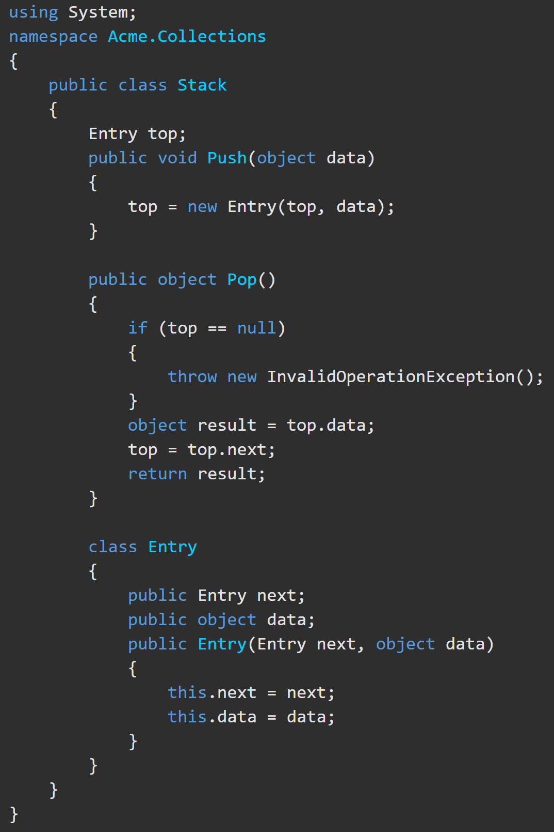
C# Program Structure https://docs.microsoft.com/en-us/dotnet/csharp/tour-of-csharp/program-structure
The fully qualified name of this class is Acme.Collections.Stack.
Class Stack contains several members:
The Entry class further contains three members
Will this code compile and run?
A field: top, | Two methods: Push Pop | A nested class: Entry.
Two fields: Next data | A parameterized constructor

Slide 9
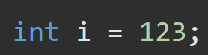
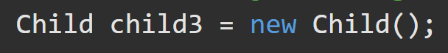
C# Structure – Data Types https://docs.microsoft.com/en-us/dotnet/csharp/tour-of-csharp/types-and-variables
C# supports two kinds of variable types:
Value types | Reference types
These are the built-in primitive data types, such as char, int, and float, as well as user-defined types declared with struct. These types directly contain their data. | Classes and other complex data types that are constructed from the primitive types. These types contain a reference to a location in memory where the data is directly held.

Slide 10
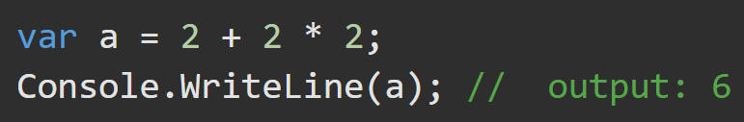
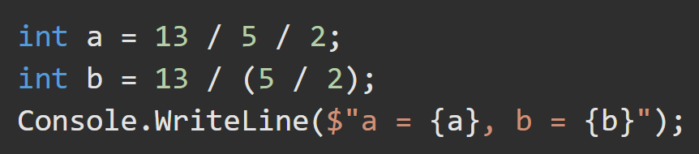
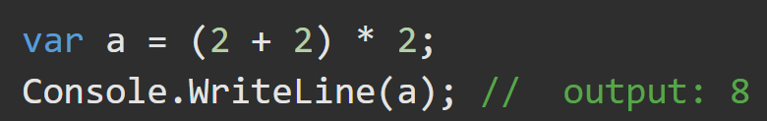
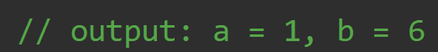
C# Structure – Expressions https://docs.microsoft.com/en-us/dotnet/csharp/tour-of-csharp/expressions https://docs.microsoft.com/en-us/dotnet/csharp/language-reference/operators/
Expressions are constructed from operands and operators.
Operators are: +, -, *, /, new
Operands are what the operators act upon: literals, fields, Local variables, expressions
Precedence of the operators controls the order in which the individual operators are evaluated. Basically, PEMDAS.

Slide 11
C# Structure – Statements https://docs.microsoft.com/en-us/dotnet/csharp/tour-of-csharp/statements
The actions of any program are expressed using statements. C# uses various statement types.
A block permits multiple statements to be written in contexts where a single statement is allowed. A block consists of a list of statements written between the delimiters { }.
Declaration statements are used to declare local variables and constants.
Expression statements are used to evaluate expressions. Expressions that can be used as statements include method invocations, object allocations using the new operator, assignments using = and the compound assignment operators, increment and decrement operations using the ++ and -- operators and await expressions.
Selection statements are used to select one of a number of possible statements for execution based on the value of some expression. This group contains the if and switch statements.
Iteration statements are used to execute repeatedly an embedded statement. This group contains the while, do, for, and foreach statements.
Jump statements are used to transfer control. This group contains the break, continue, goto, throw, return, and yield statements.

Slide 12
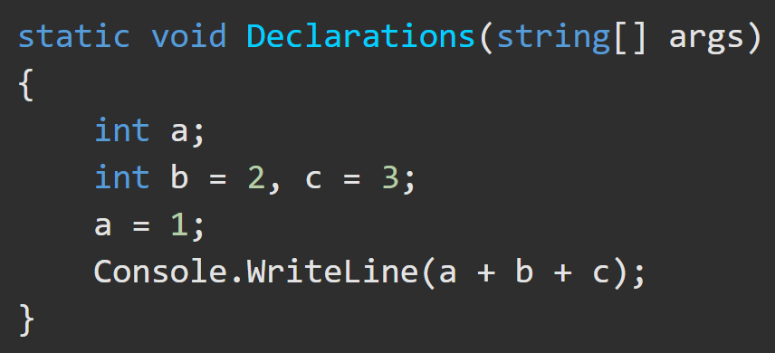
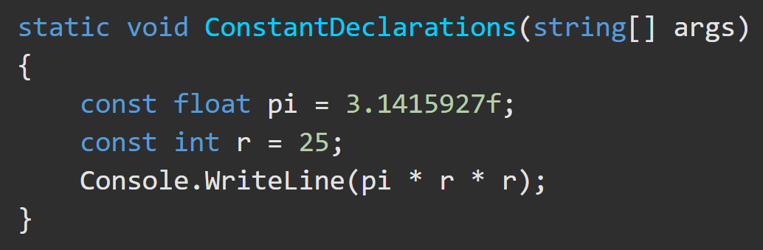
C# Structure – Block and Declaration Statements https://docs.microsoft.com/en-us/dotnet/csharp/tour-of-csharp/statements
A block permits multiple statements to be written in contexts where a single statement is allowed. A block consists of a list of statements written between the delimiters { }.
Declaration statements are used to declare local variables and constants.
Local Variable Declaration Local Constant Declaration

Slide 13
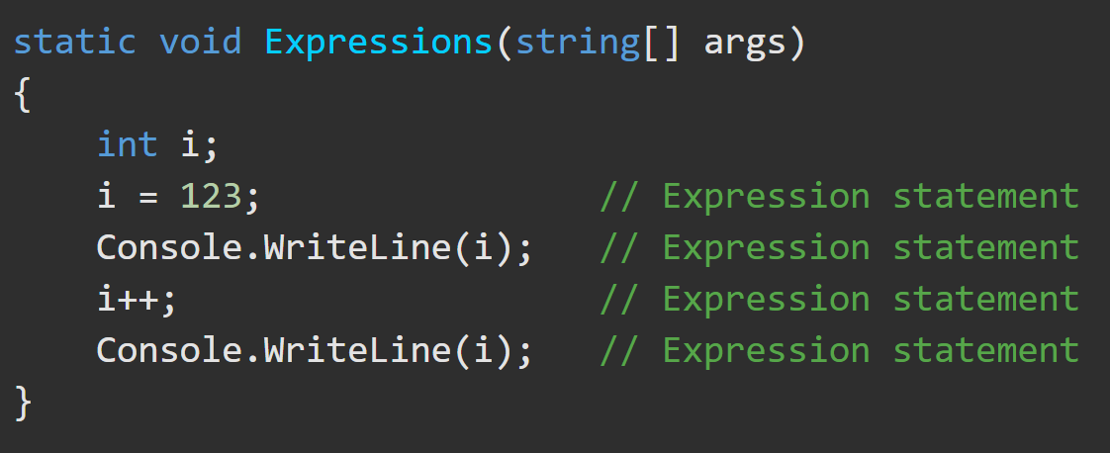
C# Structure - Expression Statements https://docs.microsoft.com/en-us/dotnet/csharp/tour-of-csharp/statements
Expression statements are used to evaluate expressions: method invocations, object allocations using the new operator, assignments using =, compound assignment operators, increment (++) and decrement (--) operations and await expressions.

Slide 14
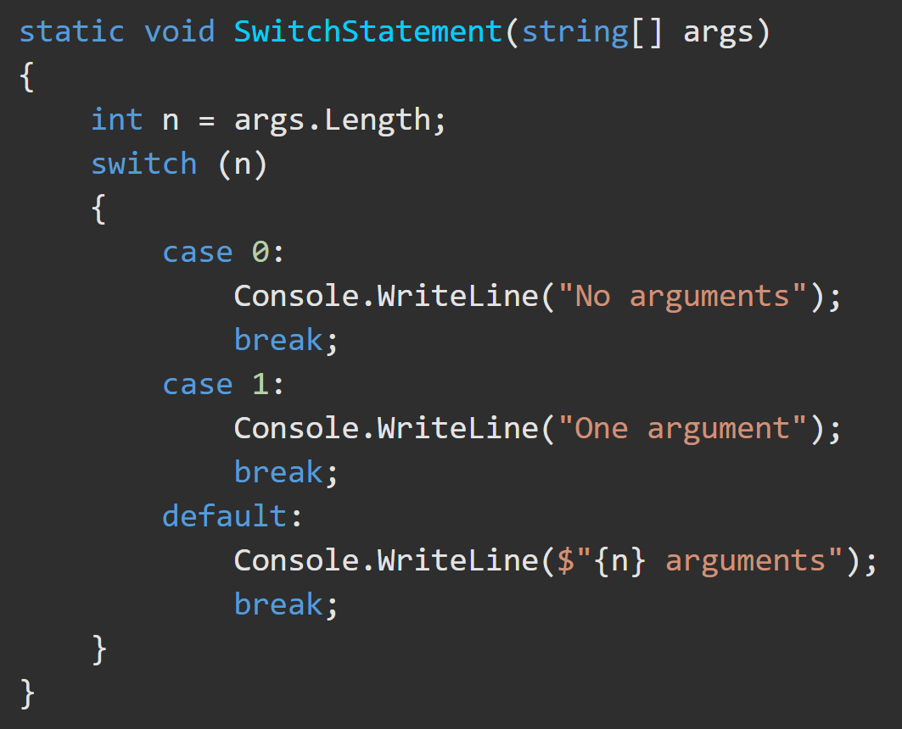
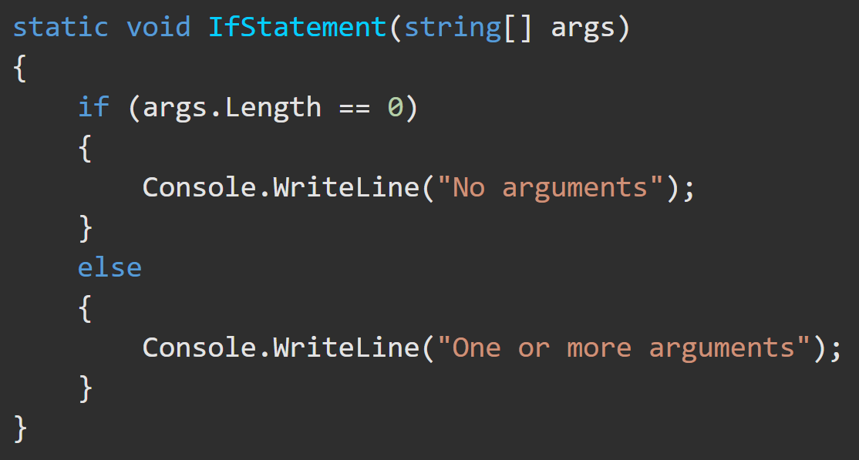
C# Structure - Selection Statements https://docs.microsoft.com/en-us/dotnet/csharp/tour-of-csharp/statements
Selection statements are used to select one of a number of possible statements for execution based on the value of some expression. This group contains the if and switch statements.

Slide 15
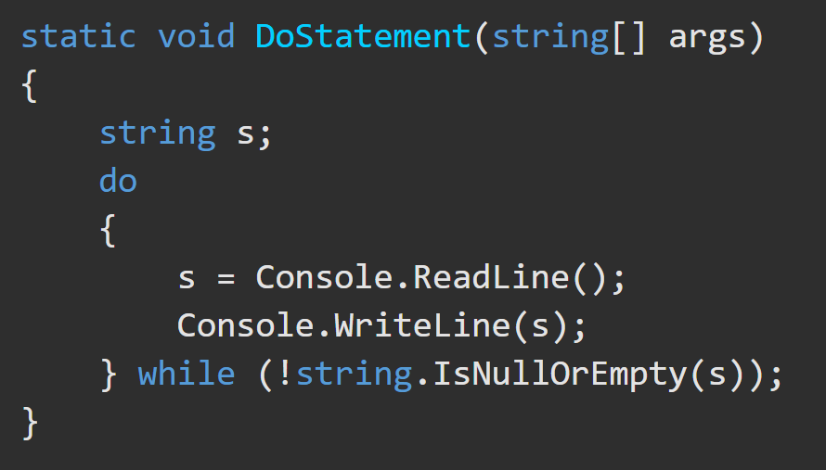
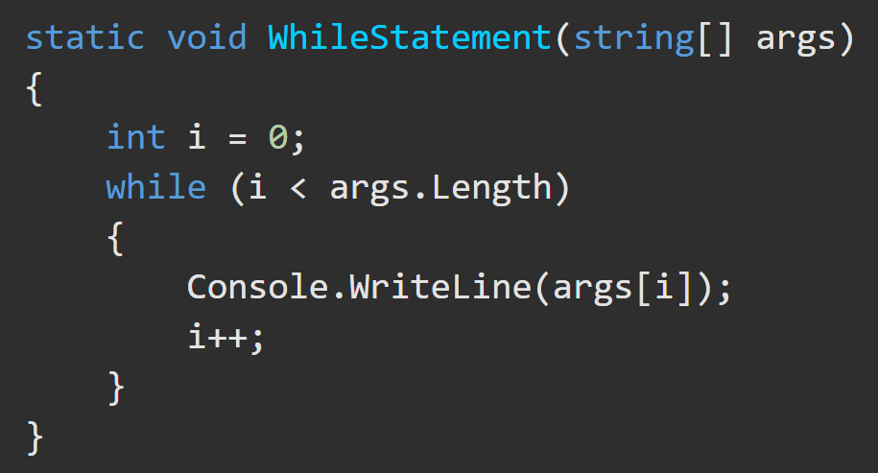
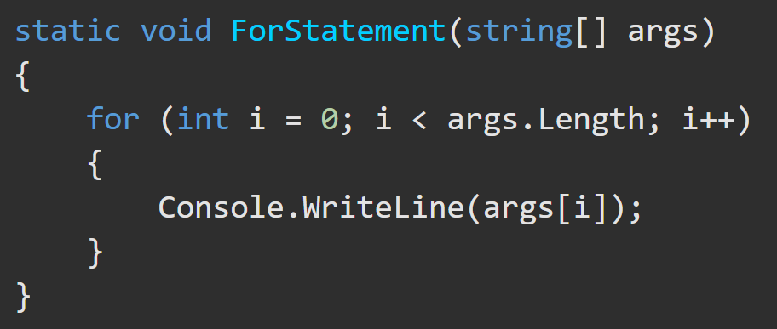
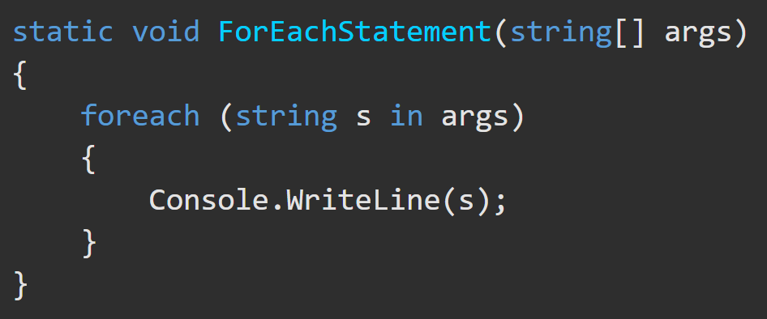
C# Structure - Iteration Statements https://docs.microsoft.com/en-us/dotnet/csharp/tour-of-csharp/statements
Iteration statements are used to execute repeatedly an embedded statement. This group contains the while, do, for, and foreach statements.

Slide 16
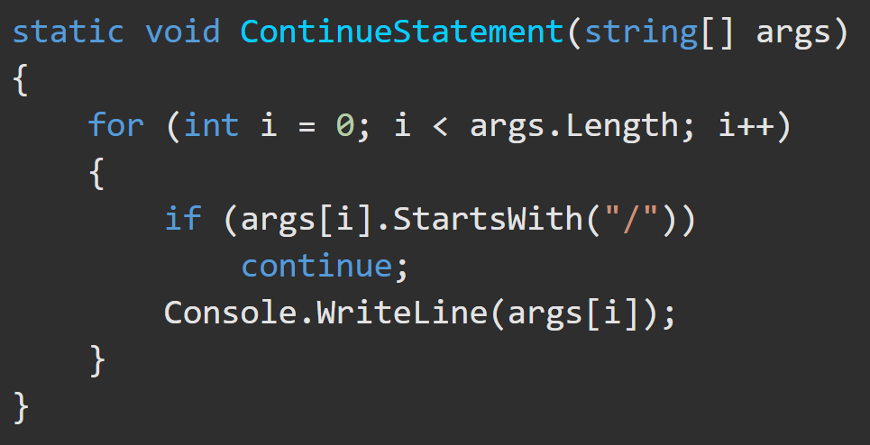
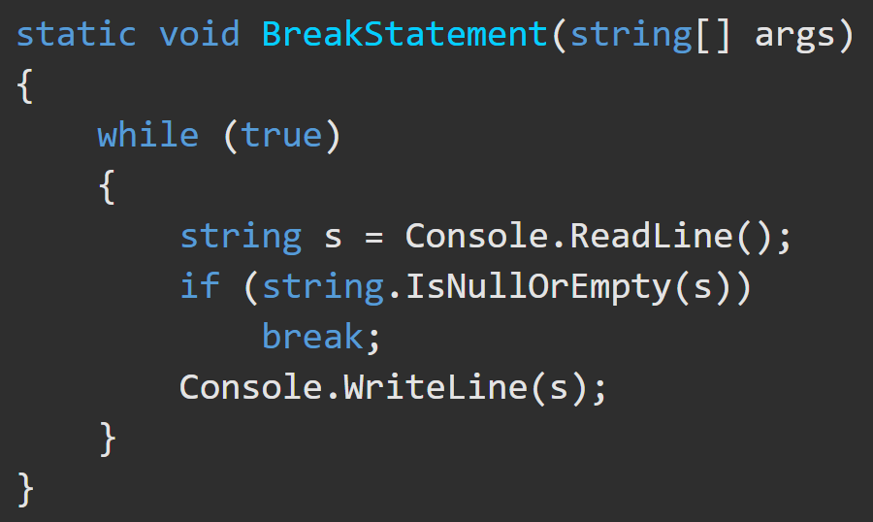
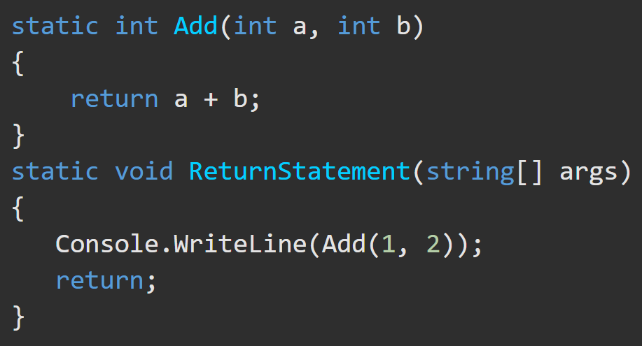
C# Structure - Jump Statements https://docs.microsoft.com/en-us/dotnet/csharp/tour-of-csharp/statements
Jump statements are used to transfer control. This group contains the break, continue, goto, throw, return, and yield statements.

Slide 17
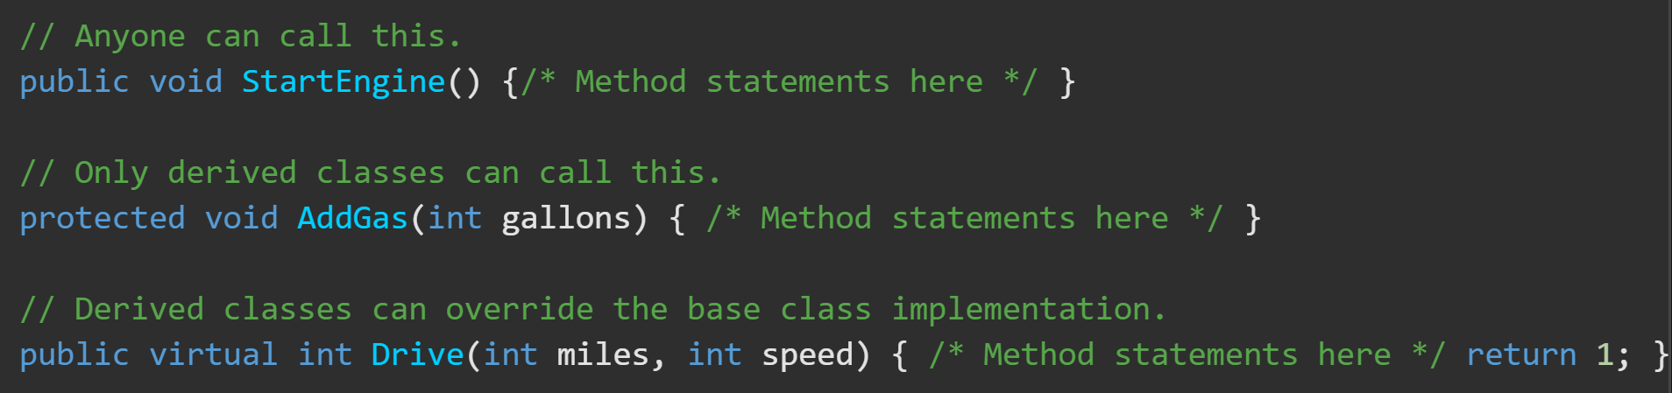
C# Structure – Methods https://docs.microsoft.com/en-us/dotnet/csharp/methods
A method (AKA, procedure, AKA, function) is a code block that contains a series of statements. A program calls the method and specifies any required method arguments.
In C#, every executed instruction is performed in the context of a method.
The Main method is the entry point for every C# application. It is called by the Common Language Runtime (CLR) when the program is started.
Methods are declared in a class or struct by specifying a method signature that contains:
(optional) access level
(optional) modifiers
Return value
Method name
Method parameters

Slide 18
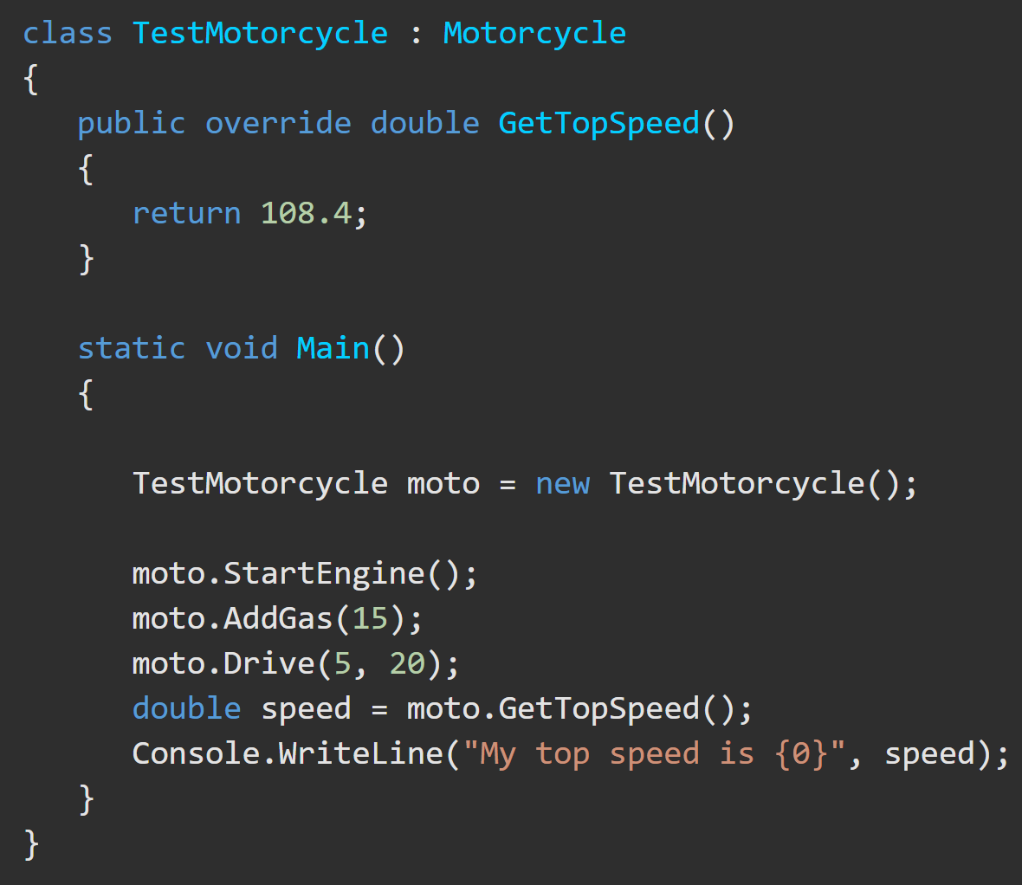
C# Structure – Method Invocation https://docs.microsoft.com/en-us/dotnet/csharp/methods#method-invocation
Methods have two forms
Instance methods
Require an object be instantiated to be called – myClassInstance.doWork()

Slide 19
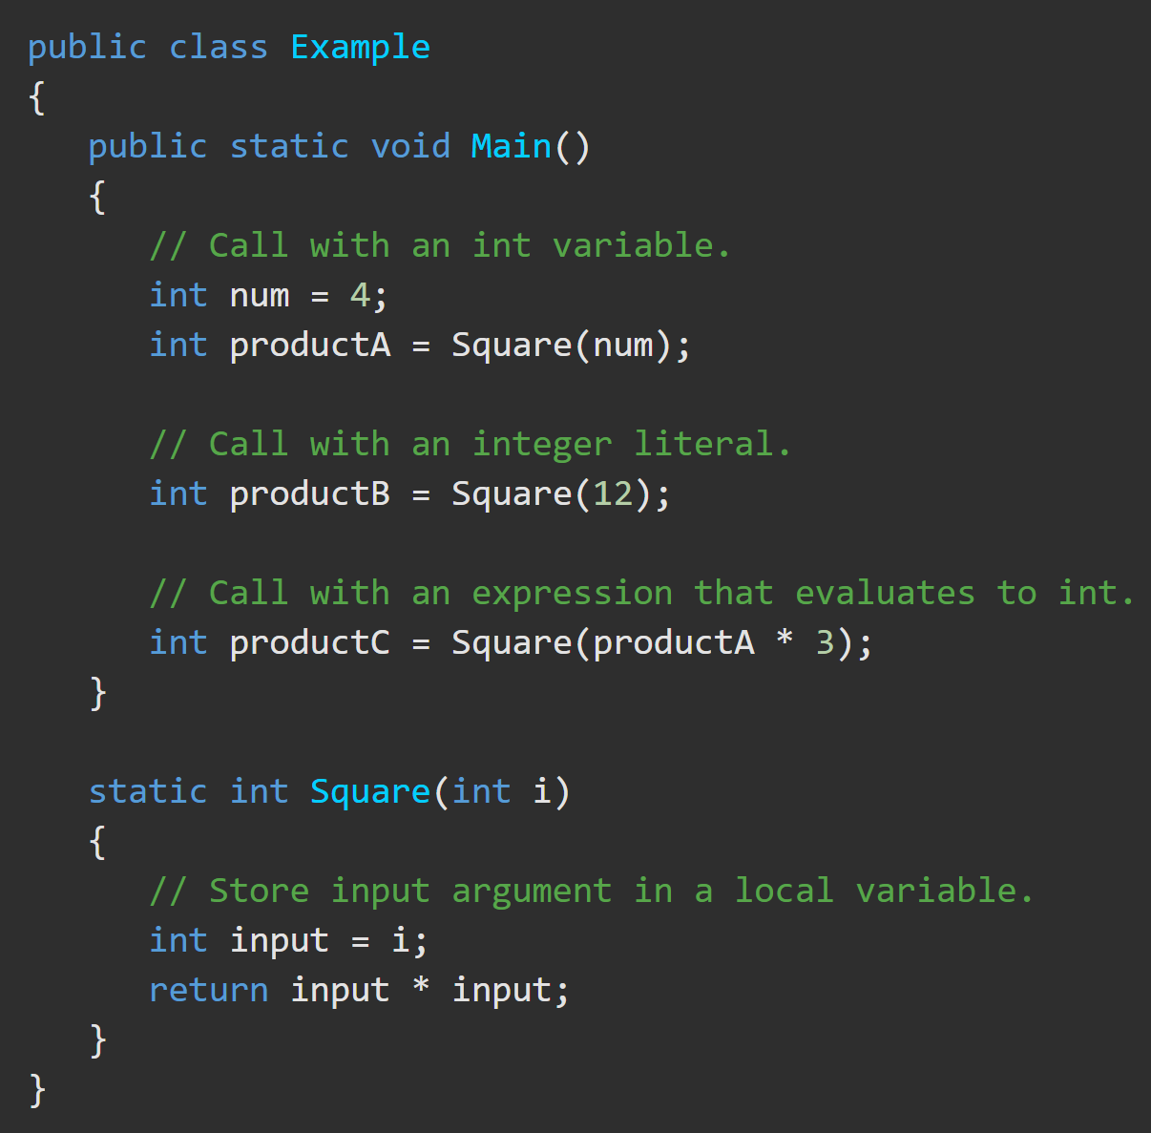
C# Structure – Method Invocation https://docs.microsoft.com/en-us/dotnet/csharp/methods#method-invocation
Methods have two forms
Static methods
Can be called without instantiating an object – myClassName.doWork()

Slide 20
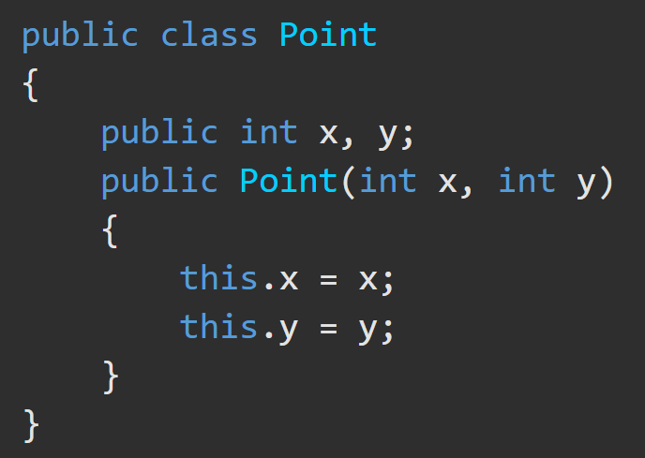
C# Structure – Classes https://docs.microsoft.com/en-us/dotnet/csharp/tour-of-csharp/classes-and-objects
Classes are the most fundamental of C#’s types.
A class is a data structure that combines state (fields) and actions (methods and other function members) in a single unit.
A class provides a template for instances of the class, known as objects.
New classes are created using class declarations.

Slide 21
C# Structure – Classes https://docs.microsoft.com/en-us/dotnet/csharp/tour-of-csharp/classes-and-objects
A class declaration starts with a header that specifies
the attributes and modifiers of the class,
the name of the class,
the base class (if given), and
the interfaces implemented by the class.
The header is followed by the class body, which consists of a list of member declarations written between the delimiters { and }.

Slide 22
C# Structure - Classes https://docs.microsoft.com/en-us/dotnet/csharp/tour-of-csharp/program-structure
The fully qualified name of this class is Acme.Collections.Stack.
Class Stack contains several members:
The Entry class further contains three members
A field: top, | Two methods: Push Pop | A nested class: Entry.
Two fields: Next data | A parameterized constructor

